Slide 1
Corporate Culture and Its Impact on Organizational Success
A Deep Dive into Values, Behavior, and Performance

Slide 2
Introduction
What is corporate culture?
Why does it matter?
How does it impact employees and business outcomes?

Slide 3

Definition of Corporate Culture
• Corporate Culture: Shared values, beliefs, attitudes, and behaviors in an organization.
• Elements:
- Leadership style
- Communication patterns
- Work environment
- Ethics and values

Slide 4
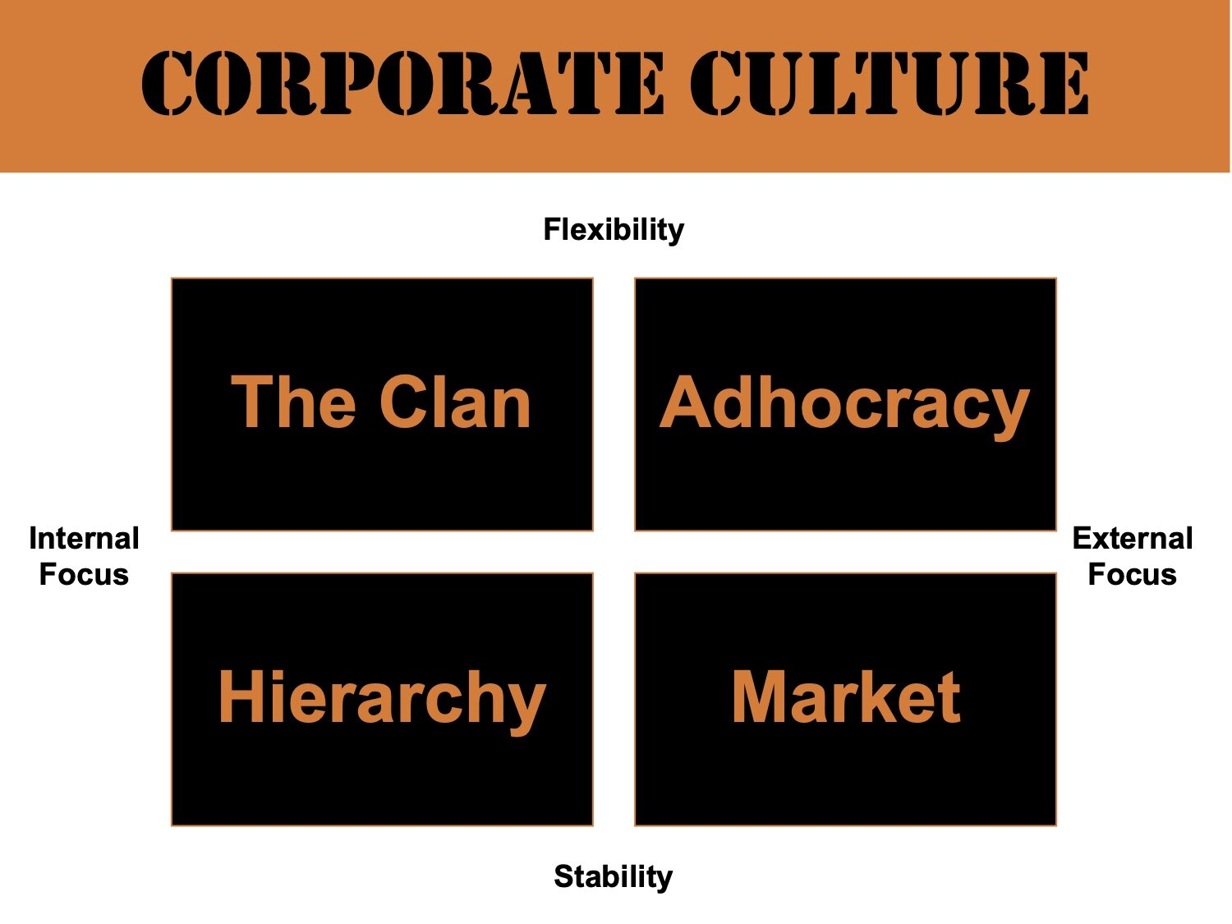
Types of Corporate Culture
1. Clan Culture – Family-like, collaboration-focused
2. Adhocracy Culture – Innovation-driven, risk-taking
3. Market Culture – Competitive, results-oriented
4. Hierarchy Culture – Structured, control-driven

Slide 5

Importance of Corporate Culture
Enhances employee engagement.
Drives productivity and innovation.
Shapes company reputation.
Attracts and retains top talent.

Slide 6
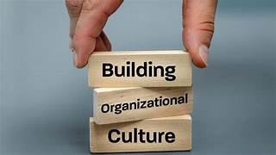
Real-World Examples
Google – Innovation and creativity
Apple – Design-driven, detail-focused
Zappos – Customer service-centric culture

Slide 7

Corporate Culture & Project Success
• Promotes collaboration across departments
• Encourages ownership and accountability
• Better decision-making
• Reduces employee turnover

Slide 8

Building a Strong Corporate Culture
• Define core values clearly
• Hire people aligned with the culture
• Leadership should model the values
• Encourage open communication
• Reward cultural alignment

Slide 9
Challenges in Maintaining Culture
• Rapid scaling or mergers
• Remote/hybrid teams
• Lack of leadership alignment
• Cultural mismatch during hiring

Slide 10

Conclusion
• Culture is essential, not optional
• Influences performance, satisfaction, and growth
• Prioritize culture for long-term success

Slide 11

Thank you for your attention!

